Slide 1
LED Cube
Using Arduino UNO

Slide 2
Contents:-

Slide 3
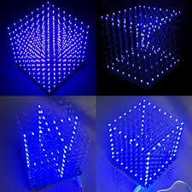
What is an LED cube?
We can shape any 3D object into the cube for
Proper imagination and explanation of objects

Slide 4
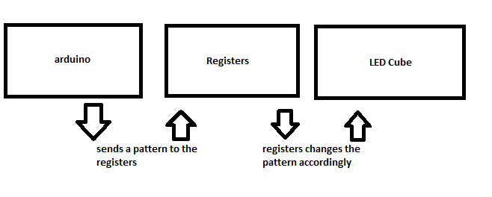

Slide 5
Components:-
74595 Shift register
Arduino UNO board
LEDs

Slide 6
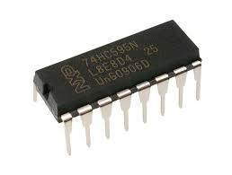
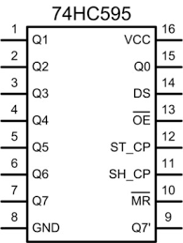
74595 ic
74595 is a shift register used to shift the pattern to the led cube given from the arduino board

Slide 7
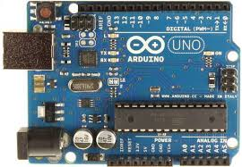
Arduino board
The Arduino Uno is an open-source microcontroller
We will use the board to store the 3D objects and pattern which are to be displayed on the LED cube

Slide 8
Refernce:-
https://github.com/VectStudio/LED_CUBE :- for assembly and application of arduino board
youtube.com/watch?v=T5Aq7cRc-mU:- for complete flowing and working of the cube

